Slide 1
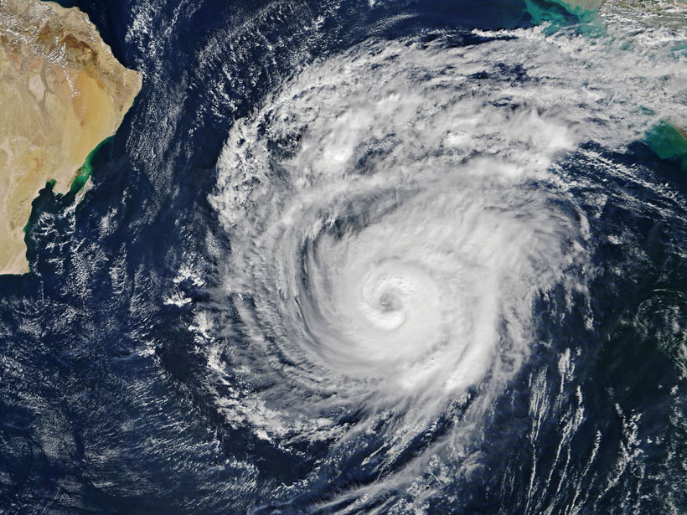
Cyclones
Cyclones are violent storms characterized by strong and high speed winds rotating about a calm center of low atmospheric pressure with wind velocity 50-250 km/hour cyclones are followed by heavy rains causing floods and destruction.

Slide 2
CYCLONES AND TSUNAMIES
CAUSES AND MANAGEMENT

Slide 3
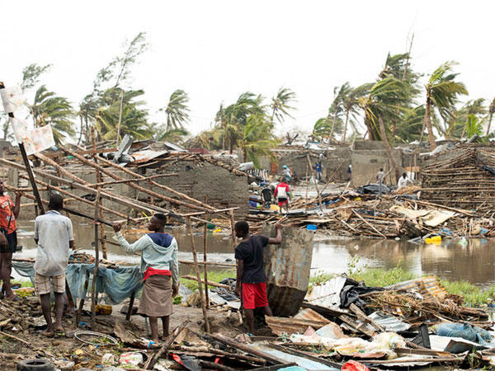

Slide 4
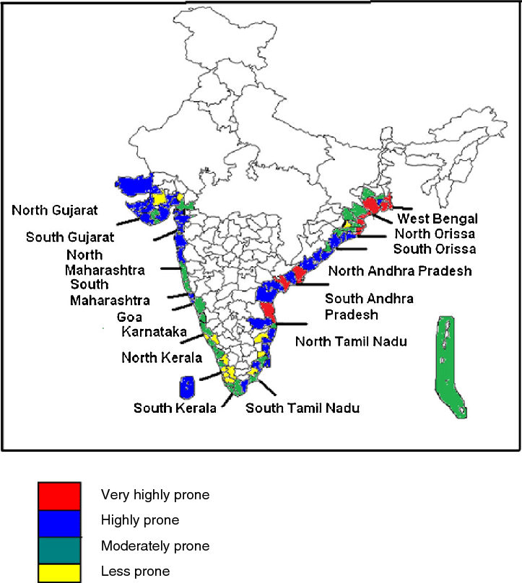

Slide 5
Effects
Light weight structure, old buildings, weak structures are at risk.
Settlements are vulnerable to floods, mudslides, landslides due to heavy rain.
Telephone and electricity poles, wires, light buildings structures such as thatched, tin, shed roof , sign boards, fishing boats, trees are most vulnerable to cyclone damages.
Due to heavy rains people, animals and their property may be washed away by floods or blown away by cyclone itself.
Cyclones along the coastal areas may cause sea water to enter inland and floods it. This may cause saline water contamination of soil & water in the affected area affecting severely water supply and affecting agriculture crops.
Management
Identify Cyclone prone areas
Green belts should be developed along the coastal areas.

Slide 6
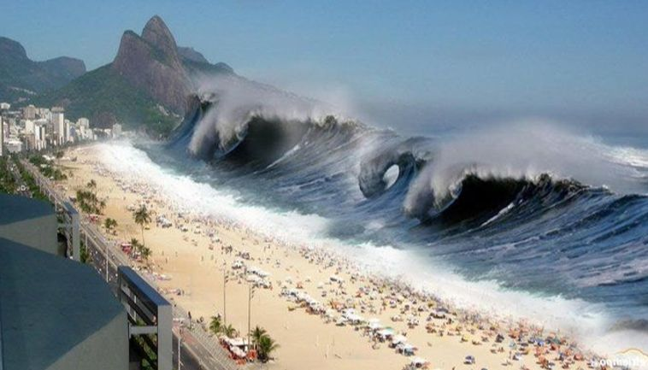
Tsunami
It is called seismic sea wave, catastrophic ocean wave caused by earthquake occurring with a magnitude greater than 6.5 on Richter scale. Under sea landslides/ volcanic eruptions may also cause tsunami.

Slide 7
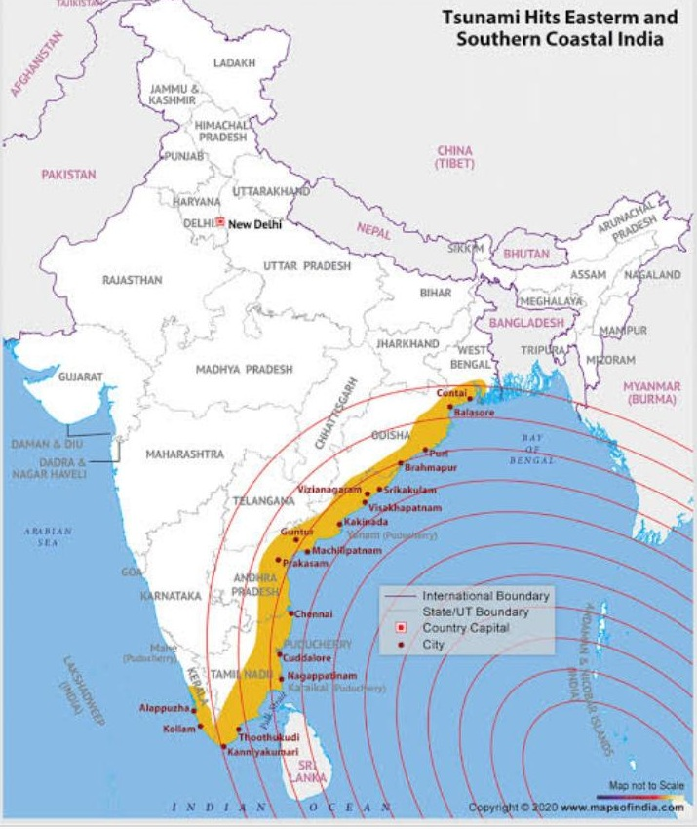

Slide 8
Tsunami a train of simple progressive oscillatory waves in propagated to great distances in ever widening circle as the wave up to height 50 m land above are seen.
Effects
Hugh water of sea enters causing floods washing away every thing
The famous tsunami of 2004 had devastating effects on coastal areas of India, Malaysia, Indonesia,Srilanka killing more than 2lac people in Asian countries other effects are same as caused by cyclones/ floods mitigation are same to those of floods.
Management
Alert by warning system and movement of animals

Slide 9
THANK YOU

